Slide 1
Maintenance of Fire protection system
Lim Shien Ming
7 Mar 2023
2 CPD Points

Slide 2
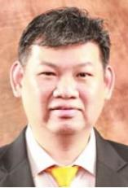
Course Facilitator
Mr. Lim Shien Ming
Mobile : 96194592 Email : shienming.lim@gmail.com
Senior Fire Safety Manager for IR , Super High Rise, Nursing Home, Mixed Development, Light Industry
Qualified Workplace Safety Health Officer
Qualified CERT instructor / ACTA trainer
BEnvOSHGrad
Adjunct Lecturer, FSM course
Speaker for events hosted by SCDF / NFEC / FSMAS / CAG(AES)
Fire Rescue Coordinator for USS amusement rides
Education Chairman, Fire Safety Manager Association (Singapore)

Slide 3
Fire Technology & relevant Singapore Standards / Code of Practise
Sprinklers CP 52
Fire Alarm / Detectors SS 645 (Former CP 10)
Emergency Voice Comms SS 546
Fire Extinguishers SS 578
Hydrants, Wet / Dry Rising Mains, Hosereels SS 575
Smoke Control Chapter 7 ( Fire Code / SS 553)

Slide 4
Maintenance is to be carried out by System Vendor Competent Person
Testing and certification is to done by Professional Engineer

Slide 5
Fire Detection & Alarm System
SS 645: 2019 (Installation and servicing of electrical fire alarm system)
Automatic fire detection and alarm system must be regularly inspected and tested to satisfactory standard in accordance with the requirements of SS 645
Testing and Maintenance of Fire Detection and Alarm System:
Visual Inspections
Functional testing of indicator panels
Field testing of initiating devices
Testing of Building services response to fire alarm

Slide 6
SS 645: 2019 (Installation and servicing of electrical fire alarm system)
Automatic fire detection and alarm system must be regularly inspected and tested to satisfactory standard in accordance with the requirements of SS 645
Testing and Maintenance of Fire Detection and Alarm System:
Visual Inspections
Check that all equipment are of approved type
Check locations, spacing are in accordance to approved drawings
Check conditions of conduits trunkings and paintwork
Check conditions of initiating devices
Check detectors and other initiating devices are not obstructed
Check zone chart for correct locations of initiating devises

Slide 7
SS 645: 2019 (Installation and servicing of electrical fire alarm system)
Automatic fire detection and alarm system must be regularly inspected and tested to satisfactory standard in accordance with the requirements of SS 645
Testing and Maintenance of Fire Detection and Alarm System:
Functional testing of main / sub alarm panels (MAP/SAP)
Alarm-For testing alarm condition
Normal/reset-Normal condition
Isolate/inhibit-Isolate the detection loop from the panel
Fault-Indicating fault condition
Check physical condition of batteries
Check voltage & current using a multimeter
Check battery monitoring device by disconnecting the battery terminals (Fault buzzer & battery fault indicator)
Check and test the charger monitoring device. ( cut off the AC supply fault buzzer will sound with fault indicator lighted)

Slide 8
SS 645: 2019 (Installation and servicing of electrical fire alarm system)
Automatic fire detection and alarm system must be regularly inspected and tested to satisfactory standard in accordance with the requirements of SS 645
Testing and Maintenance of Fire Detection and Alarm System:
Functional testing of main / sub alarm panels (MAP/SAP)
Check and test the earth fault supervising device
Earth fault could be initiated on the terminals of manual call points, alarm bell lines, and detector terminals (The fault buzzer will sound with earth fault indicator lighted)
Check and test the working conditions of all indicator lights
Check that the system is connected to the DECAM, and fire alarm signals are correctly transmitted to the monitoring company

Slide 9
SS 645: 2019 (Installation and servicing of electrical fire alarm system)
Automatic fire detection and alarm system must be regularly inspected and tested to satisfactory standard in accordance with the requirements of SS 645
Testing and Maintenance of Fire Detection and Alarm System:
Field testing of initiating devices
Two persons required
Monitoring activities & observations must be fed back to each other
Test manual call points for each zone by inserting key
Ensure alarm activated
Ensure activated zone correctly shown in the indicator panel
Smoke detectors.
Introduce smoke into smoke detectors
Ensure alarm activated & signal displayed in the fire indicator panel

Slide 10
SS 645: 2019 (Installation and servicing of electrical fire alarm system)
Automatic fire detection and alarm system must be regularly inspected and tested to satisfactory standard in accordance with the requirements of SS 645
Testing and Maintenance of Fire Detection and Alarm System:
Field testing of initiating devices
Heat detectors
Introduce heat using 100 Watt bulb or Hair dryer
Ensure alarm initiated, signal displayed on the indicator panel
SS 645 stipulates that the maintenance engineer should arrange to check the operation of at least 20% of the detectors in an installation each year
The selection of detectors should be made in such a way that all detectors in an installation should have been checked once in any period of 5 years

Slide 11
SS 645: 2019 (Installation and servicing of electrical fire alarm system)
Automatic fire detection and alarm system must be regularly inspected and tested to satisfactory standard in accordance with the requirements of SS 645
Testing and Maintenance of Fire Detection and Alarm System:
Testing of building services response to fire alarm
Homing of all lifts
Shut down of Air Handling Unit (AHU)
Operation of smoke extraction fans (within 60 seconds)
Operation of pressurisation fans
Open position of sliding doors
Releasing of magnetic door holders

Slide 12
Testing and Maintenance of EVC Systems
Weekly Test
Combined monthly test Fire Alarm & EVC Systems under simulated fire emergency conditions
Message transmitted over loudspeakers
Message from handset from each floor to confirm loudspeakers operating
Acknowledge from master handset
Recorded in log book

Slide 13
Monthly Test
Check
all visual & audible indicating devices at FCC
all controls, alarm signal silencing & alarm
signal transferring devices
alarm sounding devices throughout building using control at FCC
loudspeakers by actuating selectively & collectively from FCC
handsets by transmitting calls
building service facilities controlled from FCC
recording system working

Slide 14
Sprinkler System
CP 52:2004 (Automatic fire sprinkler system)
Automatic fire sprinkler system must be regularly inspected and tested to satisfactory standard in accordance with the requirements of CP 52
Testing and Maintenance of Automatic Fire Sprinkler System:
Visual Inspections
Water proving test
Testing of sprinkler pumps
Testing of sprinkler alarms
Checking of water supply

Slide 15
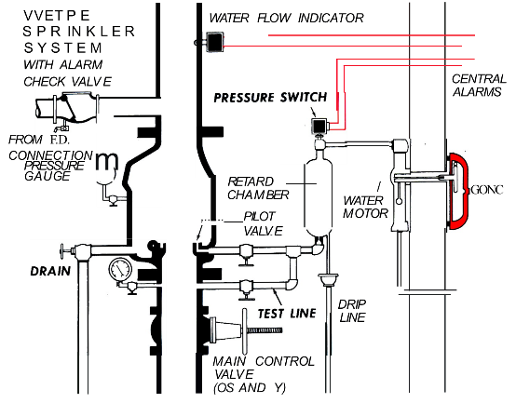
CP 52:2004 (Automatic fire sprinkler system)
Automatic fire sprinkler system must be regularly inspected and tested to satisfactory standard in accordance with the requirements of CP 52
Components of a wet sprinkler system
Two pressure gauges
Pressure switch
Retard chamber
Alarm gong
Operation of wet sprinkler system
Integrated alarms in sprinkler systems

Slide 16
CP 52:2004 (Automatic fire sprinkler system)
Automatic fire sprinkler system must be regularly inspected and tested to satisfactory standard in accordance with the requirements of CP 52
Testing and Maintenance of Automatic Fire Sprinkler System:
Visual Inspections
Sprinkler heads not obstructed/not painted over
No dust collection on sprinkler heads (industrial environments)
Corrosive vapours settling (industries)
Protective guards provided to sprinkler heads (loading & unloading areas)
System pressure & Supply pressure are almost equal.
Sprinkler stop valve in fully open position
Sprinkler drain valve & test valves are in fully closed position
Alarm motor and gong is secured fully open

Slide 17
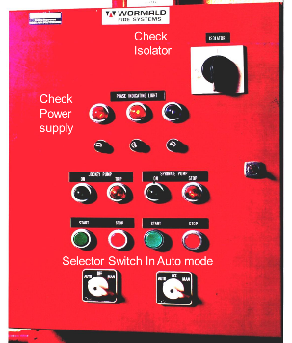
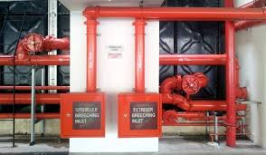
CP 52:2004 (Automatic fire sprinkler system)
Automatic fire sprinkler system must be regularly inspected and tested to satisfactory standard in accordance with the requirements of CP 52
Testing and Maintenance of Automatic Fire Sprinkler System:
Visual Inspections
Pumps in auto mode.
Sprinkler risers to indicate stories served.
Breeching inlet rigidly supported and housed in protective enclosure

Slide 18
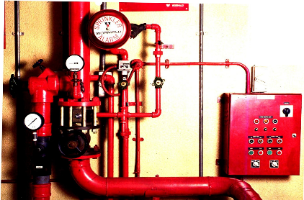
CP 52:2004 (Automatic fire sprinkler system)
Automatic fire sprinkler system must be regularly inspected and tested to satisfactory standard in accordance with the requirements of CP 52
Testing and Maintenance of Automatic Fire Sprinkler System:
Water proving test
Objectives of the water proving test are to determine :
Design flow rate achievable
Running pressure at the design flow rate
Professional Engineer (PE)/Qualified Person (QP) /Registered Inspectors (RI)
Is required to witness the water proving test and authenticate the performance

Slide 19
CP 52:2004 (Automatic fire sprinkler system)
Automatic fire sprinkler system must be regularly inspected and tested to satisfactory standard in accordance with the requirements of CP 52
Testing and Maintenance of Automatic Fire Sprinkler System:
Testing of sprinkler pumps
Arrangement of pumps for sprinkler system
One electric pump (duty) and one diesel pump (stand by); or
Two electric pumps one serving as duty and the other stand by of similar capacity, both connected to generator power supply
Check all pump suction and delivery valves are fully opened.
Check sensitivity of the jockey pump.
Cut-in cut-out pressure for the jockey pump.
Sprinkler pump starting at the pre-set pressure.
Check pump alarm indicator

Slide 20
CP 52:2004 (Automatic fire sprinkler system)
Automatic fire sprinkler system must be regularly inspected and tested to satisfactory standard in accordance with the requirements of CP 52
Testing and Maintenance of Automatic Fire Sprinkler System:
Testing of sprinkler pumps
Simulate failure of the duty pump and verify operation of stand be pump change-over mechanism
Run pump under full load for 10 minutes (NFPA) recommendation
Check for excessive noise & vibration of each pump and motor during operation
Conduct visual inspection for all glands, seals and pipeline connections to ensure no leakage
Check priming arrangements
Check alignments & coupling between the pumps
Check pumps can be stopped manually
Diesel pump if installed the problems are usually confined to the starting mechanism:
Check engine oil, water level before starting the pump
Start the pump and let it run on full load for 30 minutes. (NFPA recommendation)

Slide 21
CP 52:2004 (Automatic fire sprinkler system)
Automatic fire sprinkler system must be regularly inspected and tested to satisfactory standard in accordance with the requirements of CP 52
Testing and Maintenance of Automatic Fire Sprinkler System:
Testing of sprinkler pumps
Check battery charging equipment, and voltage.
Check battery test switch.
Ensure terminals are clean and secure, top up battery electrolyte level if necessary
Check pump control panel
Check performance of fire pump control panel for automatic & manual operations
Conduct visual inspection for conditions of all electronic components : resisters , capacitors & cables.
Ensure electrical cables and terminals are secured and tightened
Ensure all indicator lights and buzzer for correct operations
Check for panel corrosion

Slide 22
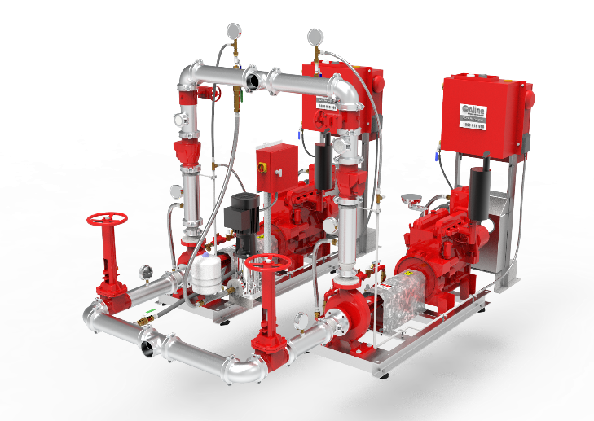
CP 52:2004 (Automatic fire sprinkler system)
Automatic fire sprinkler system must be regularly inspected and tested to satisfactory standard in accordance with the requirements of CP 52
Testing and Maintenance of Automatic Fire Sprinkler System:
Testing of sprinkler pumps

Slide 23
CP 52:2004 (Automatic fire sprinkler system)
Automatic fire sprinkler system must be regularly inspected and tested to satisfactory standard in accordance with the requirements of CP 52
Testing and Maintenance of Automatic Fire Sprinkler System:
Testing of sprinkler alarms
Check and verify operation of all water flow equipment
Water flow gong
Pressure switches
Flow switches
Clean strainer on alarm motor in the gong
Check for general sounding of fire alarms

Slide 24
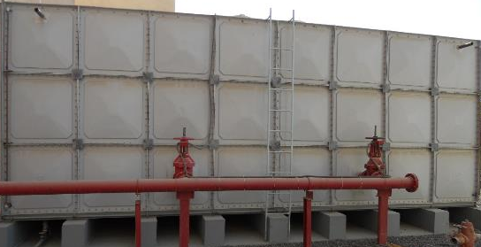
CP 52:2004 (Automatic fire sprinkler system)
Automatic fire sprinkler system must be regularly inspected and tested to satisfactory standard in accordance with the requirements of CP 52
Testing and Maintenance of Automatic Fire Sprinkler System:
Checking of water supply
Verify suction delivery and balancing valves from tank is secured fully open, strapped and padlocked
Check for water level indicator & physical water level in the tank.
Check for tank filling mechanism: PUB supply, transfer tank, transfer pumps
Water tank capacity in order

Slide 25
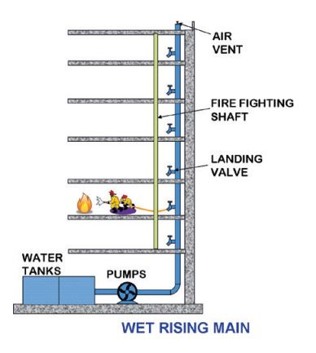
Wet Rising Main
SS 575:2012 (Fire hydrant, rising mains and hose reel systems)
Rising mains must be regularly inspected and tested to satisfactory standard in accordance with the requirements of SS 575
Testing and Maintenance of Wet Rising Main:
Visual Inspections
Flow test
Static pressure test
Testing of pumping equipment
Water supply & storage
Wet riser systems are used for buildings with habitable storey above 60m in habitable high
Wet risers are built in facility for SCDF personal to use in the event of an out break of a fire in a high-rise building
25

Slide 26
SS 575:2012 (Fire hydrant, rising mains and hose reel systems)
Rising mains must be regularly inspected and tested to satisfactory standard in accordance with the requirements of SS 575
Testing and Maintenance of Wet Rising Main:
Visual Inspections
Breeching inlet:
Clear of obstructions
Housed in protective enclosure & rigidly supported
Painted red and labelled “Wet riser breeching inlet”
Stack numerically differentiated

Slide 27
SS 575:2012 (Fire hydrant, rising mains and hose reel systems)
Rising mains must be regularly inspected and tested to satisfactory standard in accordance with the requirements of SS 575
Testing and Maintenance of Wet Rising Main:
Visual Inspections
Breeching inlet:
Breeching inlet connected to wet riser water tank or transfer tank
Location of breeching inlets are according to plan

Slide 28
SS 575:2012 (Fire hydrant, rising mains and hose reel systems)
Rising mains must be regularly inspected and tested to satisfactory standard in accordance with the requirements of SS 575
Testing and Maintenance of Wet Rising Main:
Visual Inspections
Riser pipes:
Number of riser stacks in order
Direction of flow indicated
Earthling provided
Fire rated cover for pipe sections passing through unprotected areas
Air release valve provided

Slide 29
SS 575:2012 (Fire hydrant, rising mains and hose reel systems)
Rising mains must be regularly inspected and tested to satisfactory standard in accordance with the requirements of SS 575
Testing and Maintenance of Wet Rising Main:
Visual Inspections
Landing Valves:
Conditions of hand wheel satisfactory
Strapped & padlocked
Pressure reducing facility provided if applicable
Riser numbers clearly indicated
Clear of obstructions
Painted in red

Slide 30
SS 575:2012 (Fire hydrant, rising mains and hose reel systems)
Rising mains must be regularly inspected and tested to satisfactory standard in accordance with the requirements of SS 575
Testing and Maintenance of Wet Rising Main:
Flow test
The wet riser system are tested for sufficient discharge flow under gravity feed or pump operation
The minimum discharge stipulated in the SS 575 as follows:
Commercial buildings – 38 litre/s
Residential buildings – 27 litre/s

Slide 31
SS 575:2012 (Fire hydrant, rising mains and hose reel systems)
Rising mains must be regularly inspected and tested to satisfactory standard in accordance with the requirements of SS 575
Testing and Maintenance of Wet Rising Main:
Flow test
The procedure is first hydraulically critical landing valve must be identified. Usually the highest or lowest landing valve in the riser stack is subjected to flow test.

Slide 32
SS 575:2012 (Fire hydrant, rising mains and hose reel systems)
Rising mains must be regularly inspected and tested to satisfactory standard in accordance with the requirements of SS 575
Testing and Maintenance of Wet Rising Main:
Flow test
A hydrant flow testing nozzle is connected to the landing valve and the flow is measured

Slide 33
SS 575:2012 (Fire hydrant, rising mains and hose reel systems)
Rising mains must be regularly inspected and tested to satisfactory standard in accordance with the requirements of SS 575
Testing and Maintenance of Wet Rising Main:
Flow test
The code of practice also permits testing wet riser system by opening three landing valves concurrently and measuring the cumulative flow
The average cumulative flow should be greater than 38 l/s.

Slide 34
SS 575:2012 (Fire hydrant, rising mains and hose reel systems)
Rising mains must be regularly inspected and tested to satisfactory standard in accordance with the requirements of SS 575
Testing and Maintenance of Wet Rising Main:
Static pressure test
Identify hydraulically critical landing valves for static pressure.
The maximum static pressure at the critical landing valves should not exceed 8 bars
Static pressure could be measured by pressure gauge which can be fixed on the landing valves

Slide 35
SS 575:2012 (Fire hydrant, rising mains and hose reel systems)
Rising mains must be regularly inspected and tested to satisfactory standard in accordance with the requirements of SS 575
Testing and Maintenance of Wet Rising Main:
Testing of pumping equipment is similar to sprinkler system
Water supply & storage checking procedures are similar to sprinkler system

Slide 36
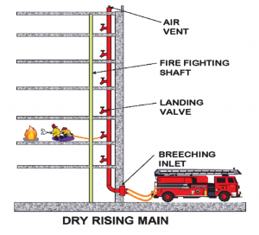
Dry Rising Main
SS 575:2012 (Fire hydrant, rising mains and hose reel systems)
Rising mains must be regularly inspected and tested to satisfactory standard in accordance with the requirements of SS 575
Testing and Maintenance of Dry Rising Main:
Visual Inspections
Hydrostatic Pressure Testing
Dry riser systems are used for buildings with habitable storey above 10m to 60m in habitable high
Dry risers are built in facility for SCDF personal to use in the event of an out break of a fire in a high-rise building
36

Slide 37
SS 575:2012 (Fire hydrant, rising mains and hose reel systems)
Rising mains must be regularly inspected and tested to satisfactory standard in accordance with the requirements of SS 575
Testing and Maintenance of Dry Rising Main:
Visual Inspections
Breeching inlet
Riser pipe
Landing valves
Inspections are similar to wet rising mains system

Slide 38
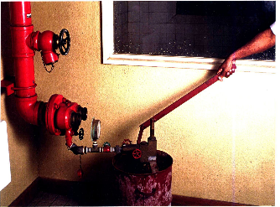
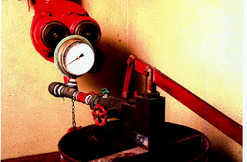
SS 575:2012 (Fire hydrant, rising mains and hose reel systems)
Rising mains must be regularly inspected and tested to satisfactory standard in accordance with the requirements of SS 575
Testing and Maintenance of Dry Rising Main:
Hydrostatic Pressure Testing:
Charge the rise stack with water using a hand pump or a motorised pump and develop a pressure of 200psi or 14 bar and lock the valve so that you will be able to observe any pressure drop
The pressure must remain unchanged for 2 hours

Slide 39
Smoke Control System
SS 553 (Mechanical ventilation and air-conditioning in building)
Mechanical ventilation system must be regularly inspected and tested to satisfactory standard in accordance with the requirements of SS 553
Staircase Pressurisation System
Check the pressurisation system automatically activated upon the activation of the fire alarm
Fans operate at higher speed if two-speed system is installed
Fans operate immediately if single speed system is installed
Check fans are capable of operating under PUB power & secondary power supply
Check Average air flow across doors when any two consecutive storey and the main exit door are opened simultaneously opened should not be less than 1m/s

Slide 40
Staircase Pressurisation System
Check air pressure not less than 50 pa
Check air pressure not to exceed 60 pa
Check force required to open any door should not exceed 110 Newtons
Check fans can be stopped manually

Slide 41
Smoke Control System
Check smoke extraction fans operate with the activation of fire alarm.
Check external open doors used as replacement air ( doors open automatically)
Smoke curtains if installed should lower with the activation of the fire alarm
Check smoke extraction system connected to PUB & Secondary power supply, & able to operate under PUB and secondary power supply.
Check smoke extraction fans start and stopped manually

Slide 42
Summary

Slide 43
Maintenance is to be carried out by System Vendor Competent Person
Testing and certification is to done by Professional Engineer

Slide 44
Thank you
Lim Shien Ming
Association of Strata Managers
www.asm.org.sg
Email: secretariat@asm.org.sg

